Slide 1

Berlin City
Sonia Sadeghian
Teacher: Sasani Nezhad

Slide 2
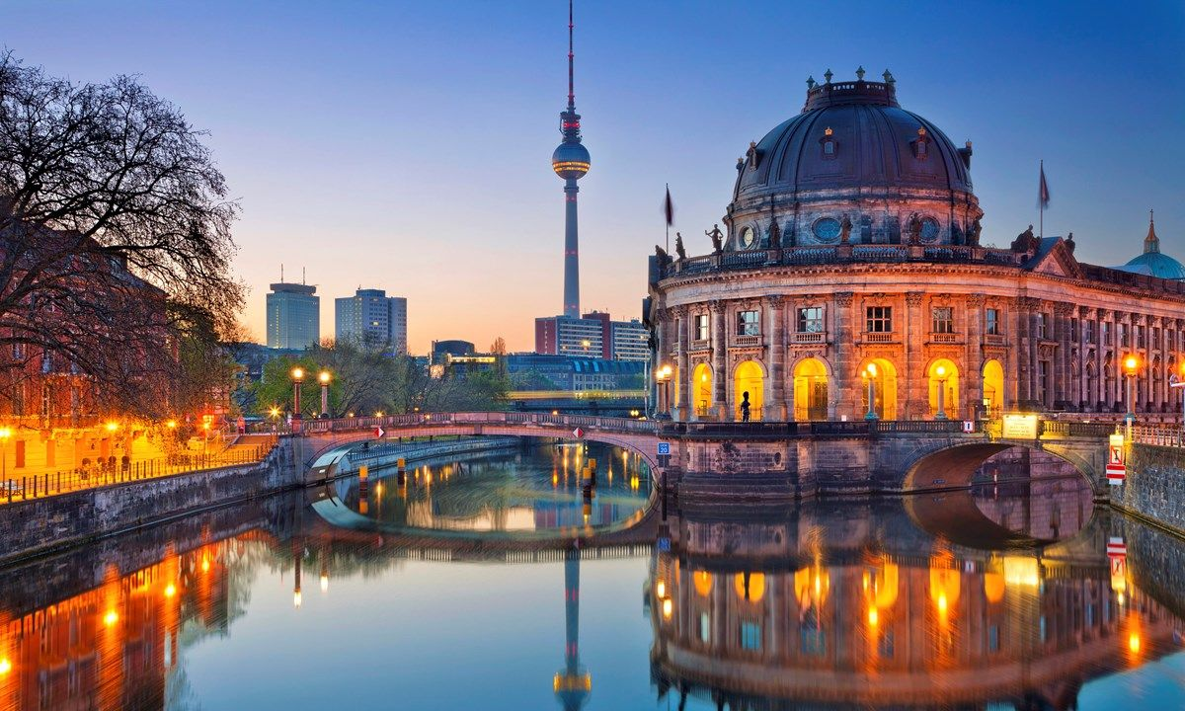
Berlin is the capital city of Germany. It is the largest city in the European Union by population, with around 3.7 million people in 2020. Berlin residents come from about 190 different countries.
The city is in the eastern part of Germany in Central Europe and is surrounded by many forests and lakes. Berlin has an area of 891 km2. The rivers Havel, Dahme and Spree run through Berlin. It has a temperate climate.

Slide 3
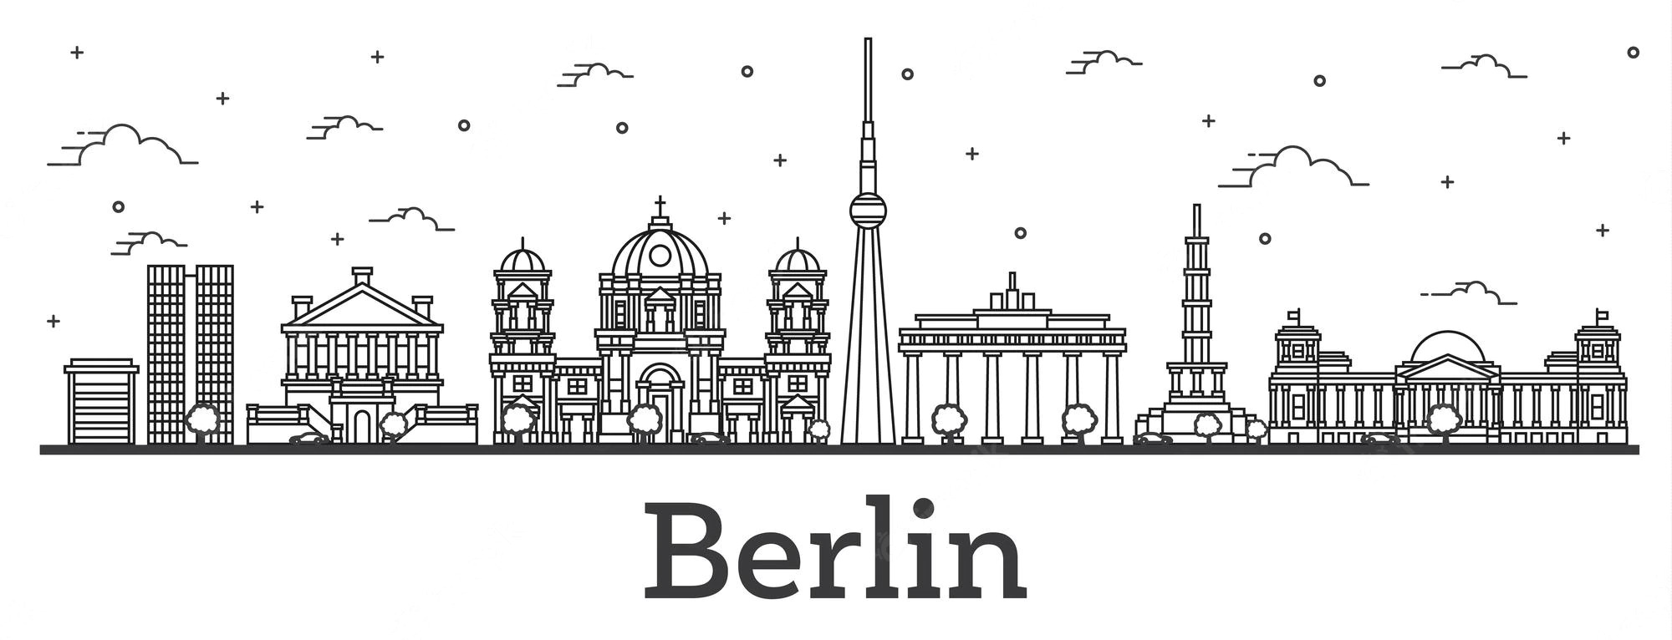
Berlin is an important city for the history of Germany. The King of Prussia and the Emperor of Germany lived in Berlin. The government of Germany was in Berlin for many years. Bombs destroyed many buildings in the city in World War Two. The city was split into West Berlin and East Berlin after World War Two. After the Berlin Wall was built in 1961 very few people were allowed to cross from East Berlin into West Berlin. The wall divided the city until 1989 when the East German government decided to allow anyone to cross, and people decided to tear down the wall.

Slide 4
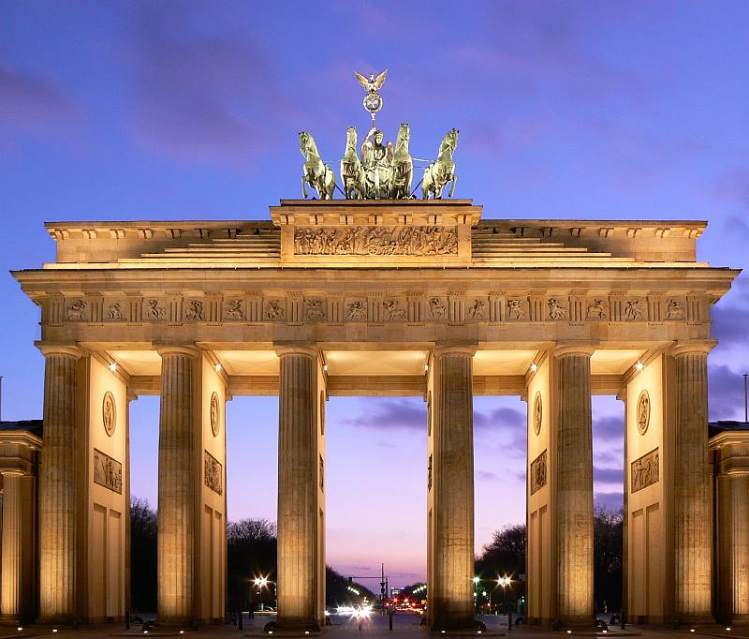
The Brandenburg Gate
(German: Brandenburger Tor) is a structure in Berlin, Germany. It is the only remaining gate through which people used to enter Berlin. It was built between 1788 and 1791.
The Brandenburg Gate has twelve columns, six on the entrance side and six on the exit. The columns form five roadways, citizens originally were allowed to use only the outer two.

Slide 5
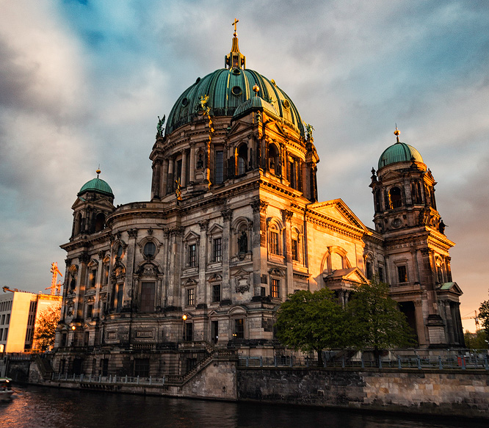
Berlin Cathedral
(German: Berliner Dom) is The Protestant Berlin Cathedral on Museum Island in the Mitte district is Berlin's largest church and one of the major sights in the city center.
It was built from 1894 to 1905 by order of German Emperor William II.
In addition to church services, the cathedral nowadays is used for state ceremonies, concerts and other events.

Slide 6
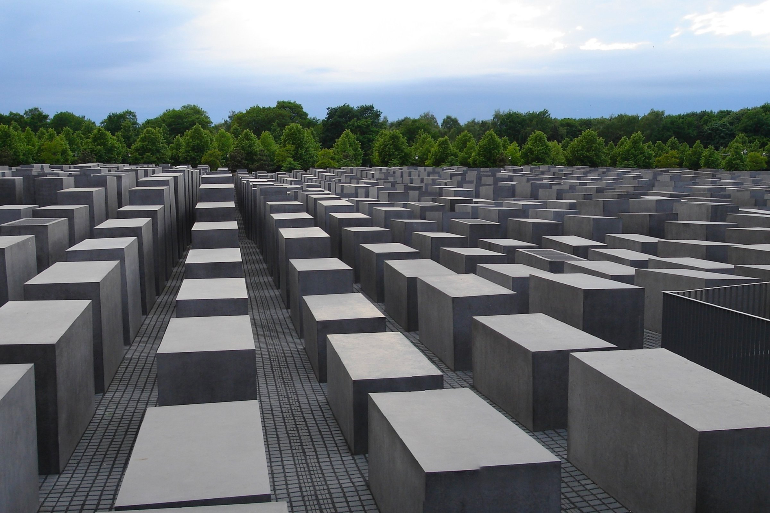
Holocaust Memorial
The Memorial to the Murdered Jews of Europe, also known as the Holocaust Memorial, is a memorial in Berlin to the Jewish victims of the Holocaust, designed by architect Peter Eisenman and Buro Happold.
Building began on 1 April 2003, and was finished on 15 December 2004. It was inaugurated on 10 May 2005, sixty years after the end of World War II in Europe, and opened to the public two days later.

Slide 7
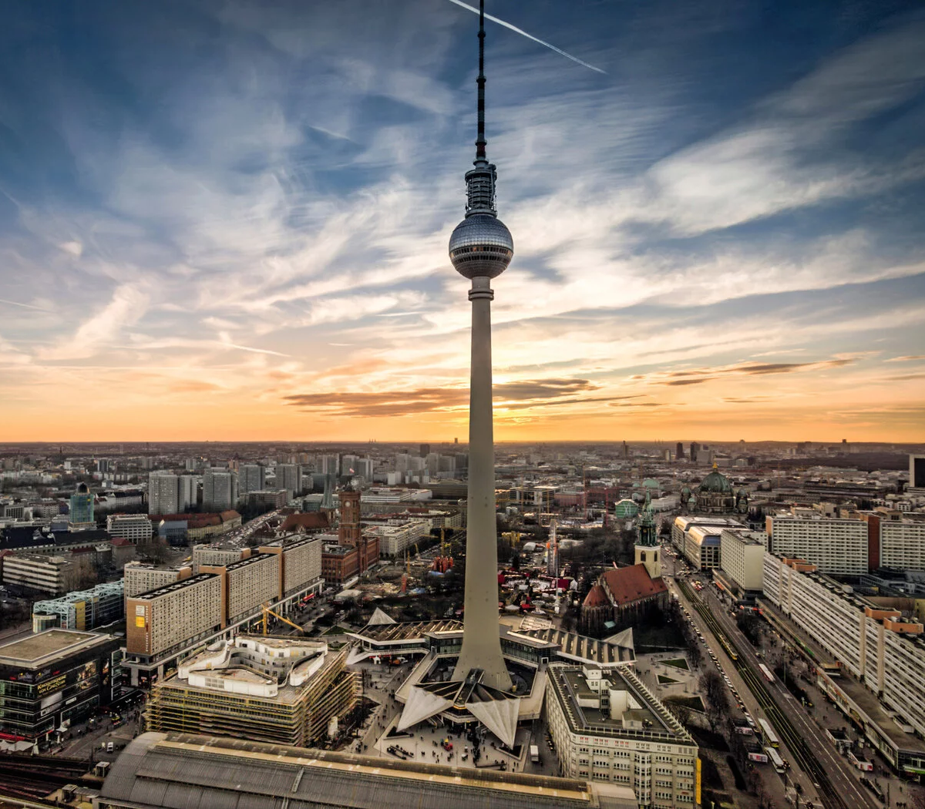
The Berlin Television Tower
The Berlin Television Tower, which is known to locals as the Fernsehturm, and is instantly recognisable from the distance, stand outs of the skyline at 368m, making it the tallest building in Berlin. Built in the 1960s, visitors to the tower can enjoy a unique 360° panorama of the city.

Slide 8
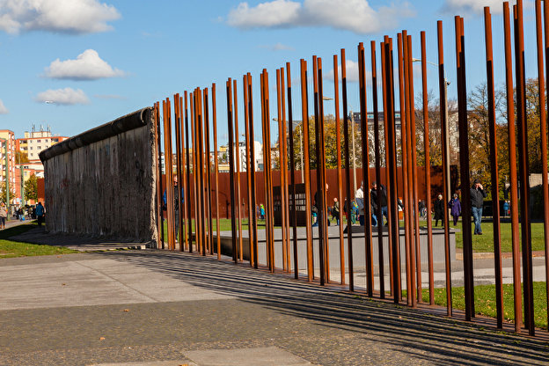
The Berlin Wall Memorial
The Berlin Wall Memorial is the central memorial site of German division, located in the middle of the capital. Situated at the historic site on Bernauer Strasse, it extends along 1.4 kilometers of the former border strip.
The memorial contains the last piece of Berlin Wall with the preserved grounds behind it and is thus able to convey an impression of how the border fortifications developed until the end of the 1980s.

Slide 9
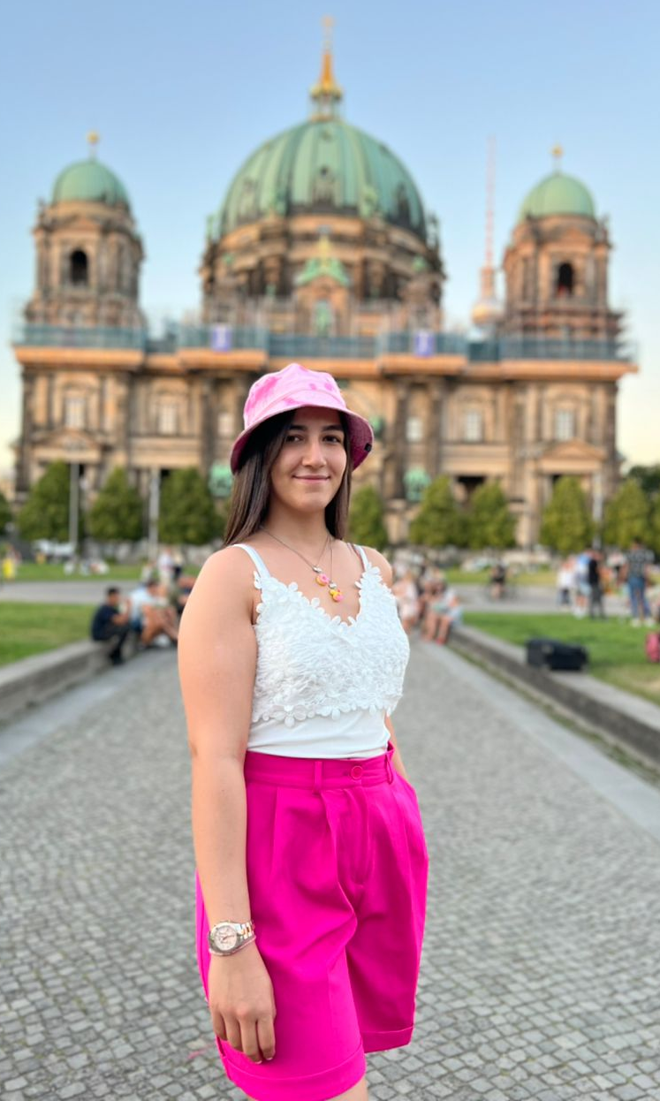
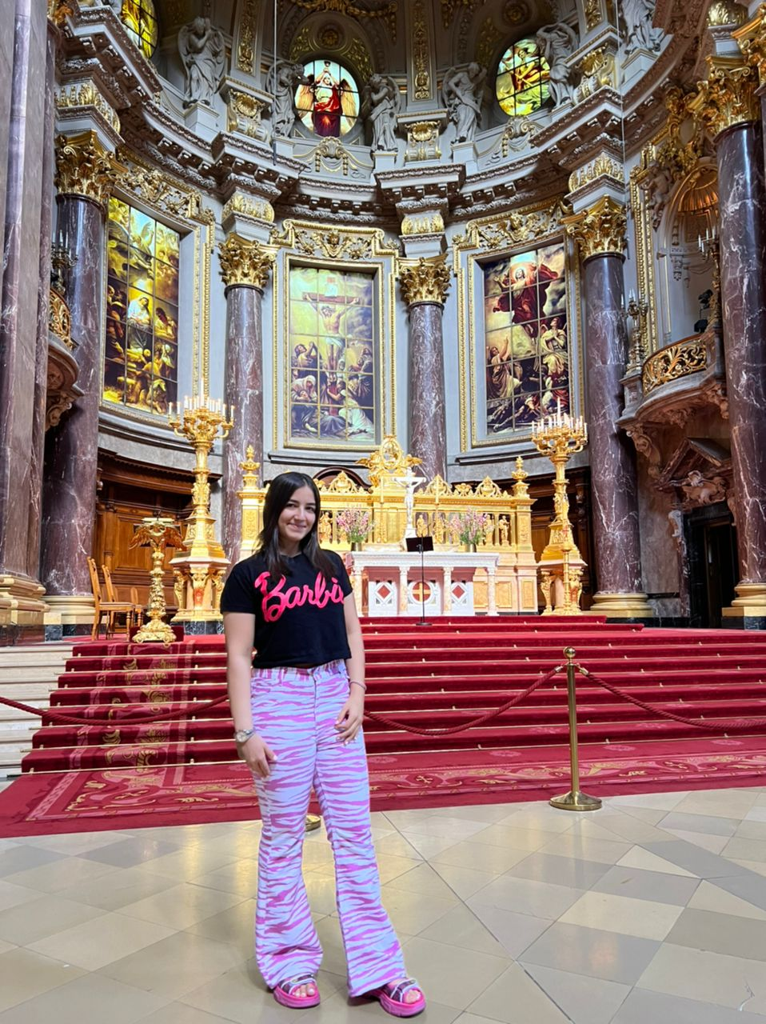
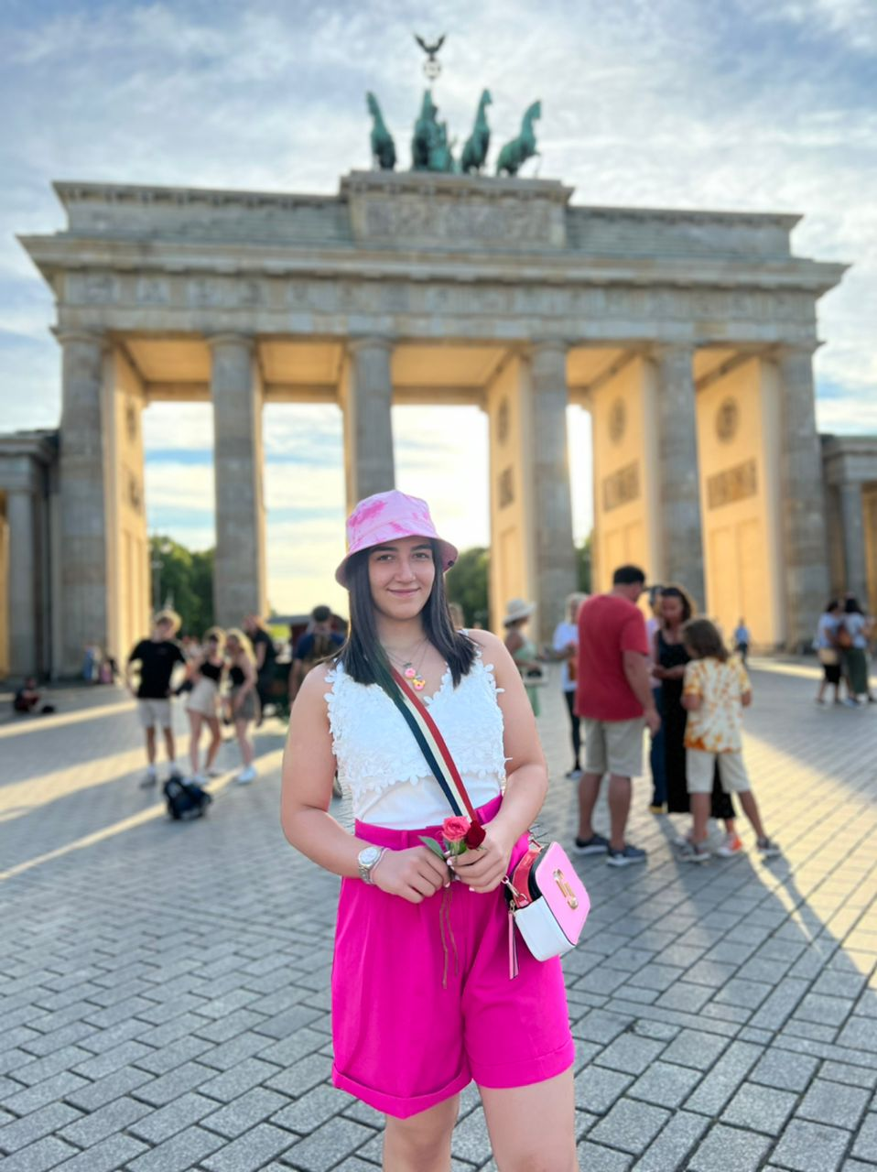
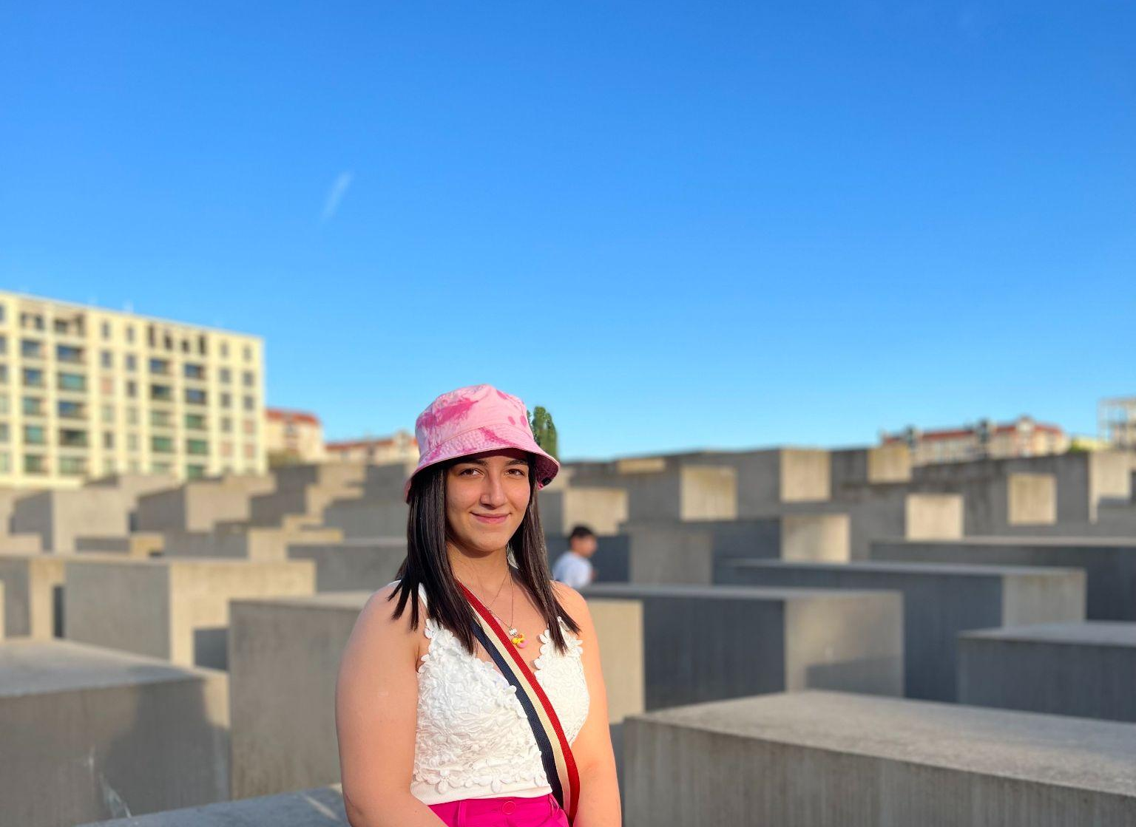

Slide 10
